Slide 1
SUMMER INTERNSHIP REVIEW
HeroHub — Employee
Self-Service Portal
Arjun C · 810023205076
B.Tech Information Technology · University College of Engineering, BIT Campus · Anna University, Tiruchirappalli
Internship at Fantasy Solution, Trichy
Notes:
This presentation reviews my 30-day internship at Fantasy Solution, Trichy. I will introduce HeroHub, explain how it was designed and built, and close with the skills gained and the future work that could take the portal toward production.

Slide 2


01 · INTERNSHIP OVERVIEW
A 30-day internship turned web concepts into a working portal
Organization: Fantasy Solution, Trichy
Focus: web development and modern app architecture
Project: HeroHub Employee Self-Service Portal
Core stack: Java 17, Spring Boot 3, Thymeleaf, HTML5, CSS3, JavaScript, Bootstrap 5
Notes:
The internship focused on web development and modern application architecture. The project was HeroHub, an employee self-service portal. The main technologies were Java 17, Spring Boot 3, Thymeleaf, HTML5, CSS3, JavaScript, and Bootstrap 5.

Slide 3

02 · THE NEED
HeroHub centralizes employee information and workforce visibility
One portal for records, search, profiles, forms, and metrics.
Challenge
Objective
Outcome
Manual records mean inconsistent formats, duplicates, and slow search.
Organize employee records in one portal.
Directory search, profiles, forms, and dashboard metrics.
Notes:
The challenge was that manual records can become inconsistent, duplicated, and slow to search. HeroHub addresses this by organizing employee records in one portal. The result combines directory search, profile views, forms, and dashboard metrics so workforce information is easier to see and use.

Slide 4
03 · DELIVERY PATH
The internship moved from fundamentals to full application delivery
Days 1–10
Days 16–26
Java, OOP, collections, exceptions, setup
Models, repository, service, controller, views
1
2
3
4
Days 11–15
Days 27–30
HTML, CSS, responsive design, Bootstrap, Spring Boot
Search, testing, docs, polish, final evaluation
Notes:
The work progressed in four stages. I began with Java foundations and object-oriented programming. I then moved into frontend and Spring Boot fundamentals, built the main application layers and modules, and finished with search, testing, documentation, polish, and final evaluation.

Slide 5
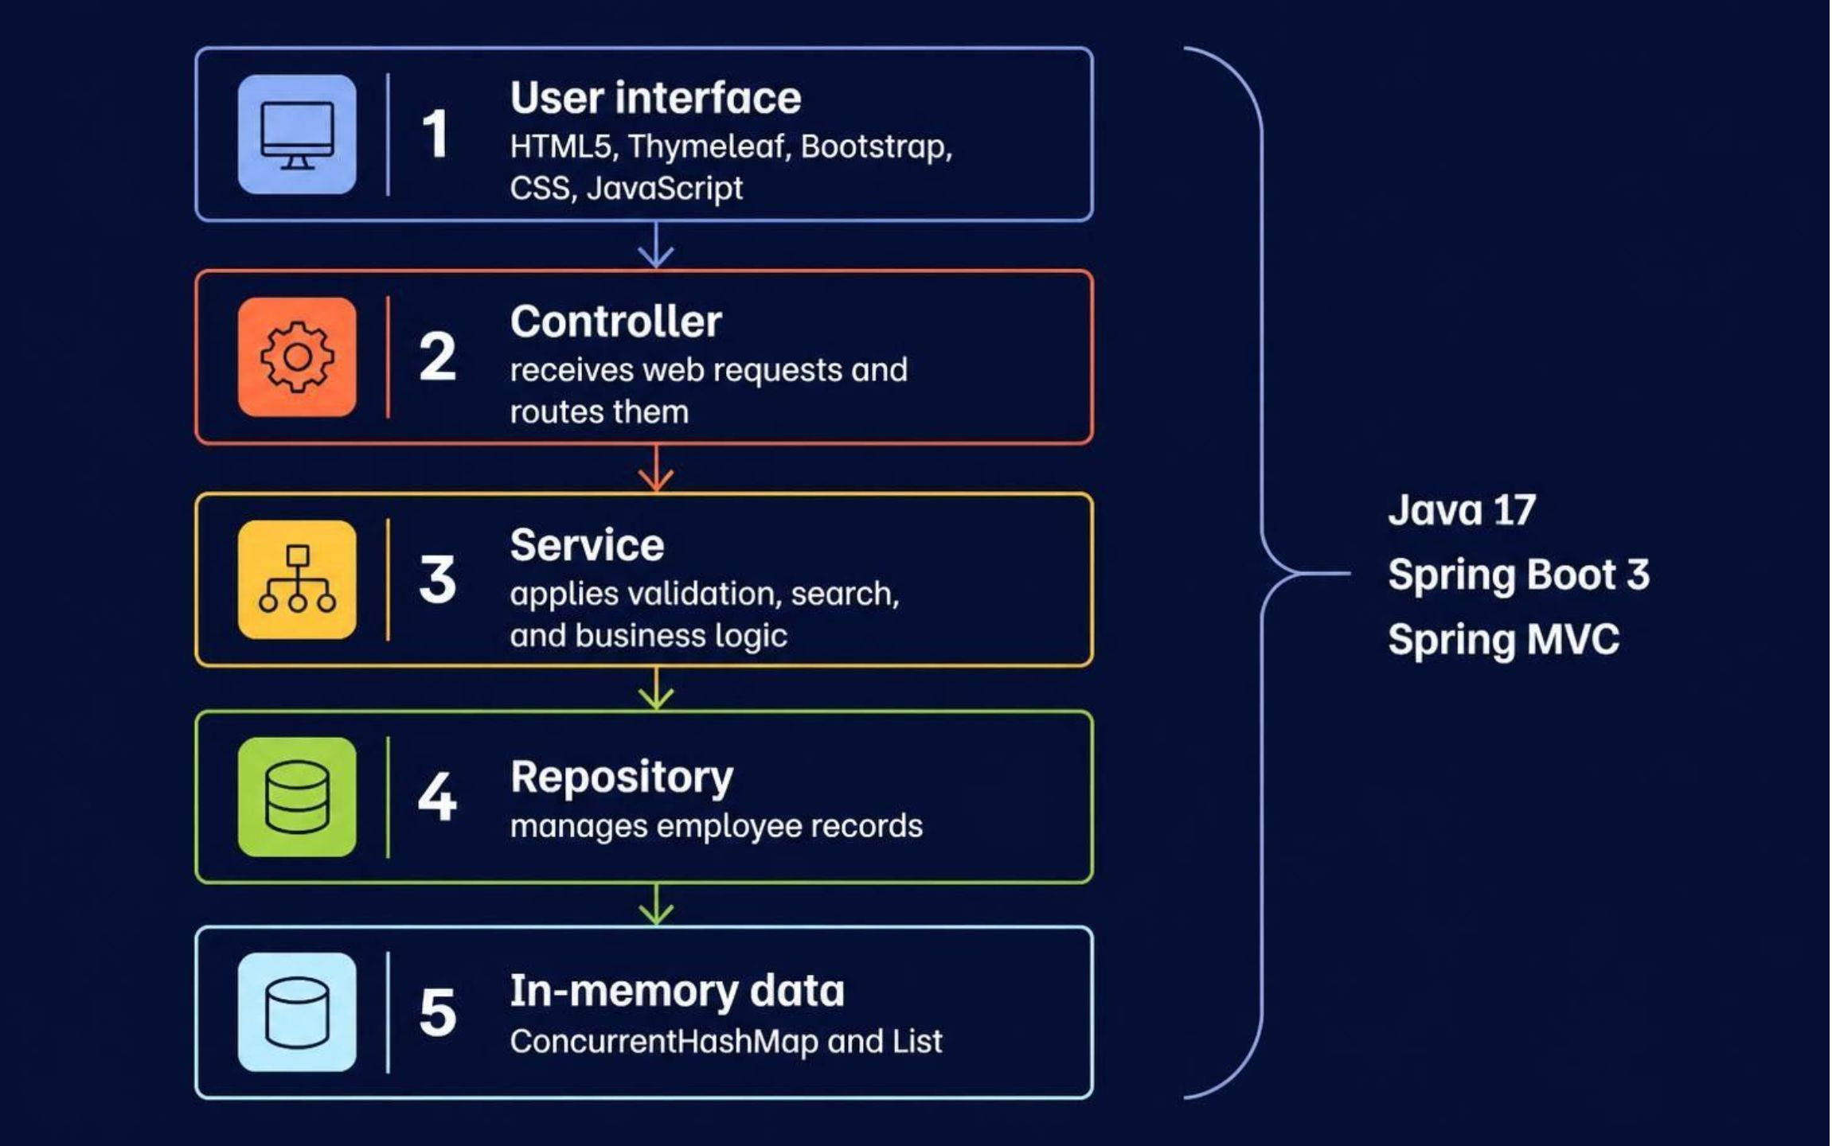
04 · ARCHITECTURE
Layered design keeps HeroHub organized and maintainable
Notes:
HeroHub uses a layered design. The user interface handles the visible pages. The controller receives web requests, the service applies validation and business logic, and the repository manages employee records. The current data layer uses ConcurrentHashMap and List in memory. This separation makes the application easier to understand and maintain.

Slide 6






05 · PORTAL FEATURES
Six features make the portal useful at a glance
Dashboard
Directory
Add / edit
Total staff, departments, average salary, breakdown
Employee list with department badges
Dual-mode employee form with validation
Profile
Search
OOP model
Individual employee detail view
Filter by ID, name, department, or designation
Employee extends the Person base class
Notes:
The portal is useful at a glance because it brings together six capabilities. The dashboard gives an overview, while the directory, forms, profile view, and search support everyday employee information tasks. The OOP model is also reflected in the application, with Employee extending the Person base class.

Slide 7
06 · USER JOURNEY
A user moves from dashboard to a filtered employee view
Object-oriented design supports the journey
01
02
03
Open HeroHub
Open directory
Search
Review the dashboard.
See the employee list.
Use Employee ID, name, department, or designation.
Encapsulation
Person keeps fields private and exposes methods.
04
05
Inheritance
View or edit
Submit request
Employee reuses Person and adds its own fields.
Open a profile or the add/edit form.
See the updated information.
Notes:
A typical user journey starts at the dashboard and continues to the employee directory. The user can search by Employee ID, name, department, or designation, then open a profile or add/edit form. The design also reflects object-oriented ideas: encapsulation keeps fields private, while inheritance lets Employee reuse Person.

Slide 8
07 · TECHNOLOGY TO OUTCOME
The project connected a modern Java stack to practical outcomes
Backend | Java 17 · Spring Boot 3 · Spring MVC
Frontend | HTML5 · CSS3 · JavaScript · Thymeleaf · Bootstrap 5
Data | ConcurrentHashMap and List for in-memory storage
Tools | Maven · Git · GitHub · IDE · embedded Tomcat
What I achieved
Built: Dashboard and employee pages
Implemented: Forms and search
Practised: Validation, testing, OOP, and layered architecture
Notes:
The technology choices connected directly to practical outcomes. The backend used Java, Spring Boot, and Spring MVC. The frontend used Thymeleaf and standard web technologies. Data was held in memory, and tools such as Maven, Git, GitHub, an IDE, and embedded Tomcat supported development. I built pages, forms, search, validation, testing, OOP, and layered architecture.

Slide 9
08 · LEARNING OUTCOME
The internship strengthened both technical skill and delivery confidence
Classroom Java and OOP became a complete portal, with architecture, testing, and debugging in practice.
Applied
Practised
08
Java and OOP concepts to a complete portal
Spring Boot, Thymeleaf views, responsive UI, testing, debugging
Separated
Built
Presentation, business logic, and data access
A stronger foundation for professional web development
Notes:
The internship helped me move from classroom knowledge to a complete working portal. I practised Spring Boot architecture, Thymeleaf views, responsive design, testing, and debugging. I also learned why presentation, business logic, and data access should be separated. Overall, the experience strengthened both technical skill and delivery confidence.

Slide 10
09 · CLOSING VIEW
HeroHub is a foundation for future production work
Completed: 30-day internship and a working employee portal
Learned: Java, Spring Boot, OOP, layered architecture, testing, debugging
Future work: persistent database, stronger authentication, report exports, deployment readiness
Thank you · Questions?
Notes:
HeroHub is the result of a 30-day internship and a strong foundation for future production work. The completed work includes a working employee portal and experience across Java, Spring Boot, OOP, architecture, integration, testing, and debugging. Future work includes a persistent database, stronger authentication and access control, report exports, and deployment readiness. Thank you. I welcome your questions.

